Slide 1
Chapter 7: Functional Testing
DINH THI MY CANH

Slide 2
Contents
Concept of functional testing
Equivalence class partitioning
Boundary value analysis
Decision tables
Random testing
Error guessing

Slide 3
1. Concept of functional testing
The four key concepts in functional testing are:
Precisely identify the domain of each input and each output variable
Select values from the data domain of each variable having important properties
Consider combinations of special values from different input domains to design test cases
Consider input values such that the program under test produces special values from the domains of the output variables
William E. Howden

Slide 4
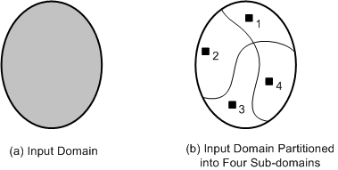
2. Equivalence class partitioning
An input domain may be too large for all its elements to be used as test input (Figure 9.8(a))
The input domain is partitioned into a finite number of subdomains
Each subdomain is known as an equivalence class, and it serves as a source of at least one test input (Figure 9.8(b))
Figure 9.8:
(a) Too many test input;
(b) One input is selected from each of the subdomain

Slide 5
Guidelines for Equivalence Class Partitioning
An input condition specifies a range [a, b]
one equivalence class for a < X < b, and
two other classes for X < a and X > b to test the system with invalid inputs
An input condition specifies a set of values
one equivalence class for each element of the set {M₁}, {M₂}, ...., {M_{N}}, and
one equivalence class for elements outside the set {M₁,M₂, ...,M_{N}}
Input condition specifies for each individual value
If the system handles each valid input differently then create one equivalence class for each valid input

Slide 6
Guidelines for Equivalence Class Partitioning
An input condition specifies the number of valid values (Say N)
Create one equivalence class for the correct number of inputs
two equivalence classes for invalid inputs – one for zero values and one for more than N values
An input condition specifies a “must be” value
Create one equivalence class for a “must be” value, and
one equivalence class for something that is not a “must be” value

Slide 7
Identification of Test Cases
Test cases for each equivalence class can be identified by:
Assign a unique number to each equivalence class
For each equivalence class with valid input that has not been covered by test cases yet, write a new test case covering as many uncovered equivalence classes as possible
For each equivalence class with invalid input that has not been covered by test cases, write a new test case that covers one and only one of the uncovered equivalence classes

Slide 8
Example
Adjusted Gross Income. Consider a software system that computes income tax based on adjusted gross income (AGI) according to the following rules:
If AGI is between $1 and $29,500, the tax due is 22% of AGI.
If AGI is between $29,501 and $58,500, the tax due is 27% of AGI.
If AGI is between $58,501 and $100 billion, the tax due is 36% of AGI

Slide 9
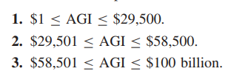

Example
In this case, the input domain is from $1 to $100 billion. There are three input conditions in the example:
First we consider condition 1, namely, $1 ≤ AGI ≤ $29,500, to derive two ECs:

Slide 10

Example
Then, we consider condition 2, namely, $29,501 ≤ AGI ≤ $58,500, to derive one EC:
Finally, we consider condition 3, namely, $58,501 ≤ AGI ≤ $100 billion, to derive two ECs:

Slide 11
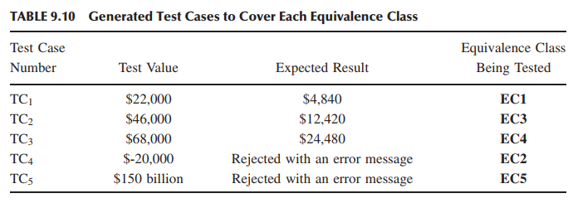
Example

Slide 12
Advantages of Equivalence Class Partitioning
A small number of test cases are needed to adequately cover a large input domain
One gets a better idea about the input domain being covered with the selected test cases
The probability of uncovparering defects with the selected test cases based on equivalence class titioning is higher than that with a randomly chosen test suite of the same size
The equivalence class partitioning approach is not restricted to input conditions alone – the technique may also be used for output domains

Slide 13
3. Boundary value analysis
The central idea in Boundary Value Analysis (BVA) is to select test data near the boundary of a data domain so that data both within and outside an equivalence class are selected
The BVA technique is an extension and refinement of the equivalence class partitioning technique
In the BVA technique, the boundary conditions for each of the equivalence class are analyzed in order generate test cases

Slide 14
Guidelines for Boundary Value Analysis
The equivalence class specifies a range
If an equivalence class specifies a range of values, then construct test cases by considering the boundary points of the range and points just beyond the boundaries of the range
For example, let an EC specify the range of -10.0 ≤ X ≤ 10.0. This would result in test data {-9.9 - 10.0, -10.1} and {9.9, 10.0, 10.1}.

Slide 15
Guidelines for Boundary Value Analysis
The equivalence class specifies a number of values
If an equivalence class specifies a number of values, then construct test cases for the minimum and the maximum value of the number
In addition, select a value smaller than the minimum and a value larger than the maximum value.
For example, let the EC specification of a student dormitory specify that a housing unit can be shared by one to four students; test cases that include 1, 4, 0, and 5 students would be developed.

Slide 16
Guidelines for Boundary Value Analysis
The equivalence class specifies an ordered set
If the equivalence class specifies an ordered set, such as a linear list, table, or a sequential file, then focus attention on the first and last elements of the set.

Slide 17
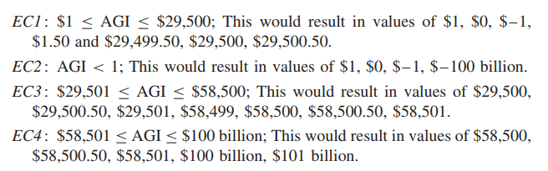
Example
Let us consider the five ECs identified in our previous example to compute income tax based on AGI. The BVA technique results in test as follows for each EC. The redundant data points may be eliminated.
Notes:
Khi phân tích giá trị biên, Mỗi miền không quá 7 TC

Slide 18
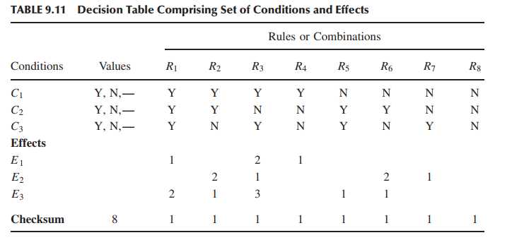
4. Decision tables
The structure of a decision table

Slide 19
4. Decision tables
It comprises a set of conditions (or, causes) and a set of effects (or, results) arranged in the form of a column on the left of the table
In the second column, next to each condition, we have its possible values: Yes (Y), No (N), and Don’t Care (“-”)
To the right of the “Values” column, we have a set of rules. For each combination of the three conditions {C1,C2,C3}, there exists a rule from the set {R1,R2, ..,R8}

Slide 20
4. Decision tables
The steps in developing test cases using decision table technique:
Step 1: The test designer needs to identify the conditions and the effects for each specification unit.
A condition is a distinct input condition or an equivalence class of input conditions
An effect is an output condition. Determine the logical relationship between the conditions and the effects
Step 2: List all the conditions and effects in the form of a decision table. Write down the values the condition can take

Slide 21
4. Decision tables
Each rule comprises a Yes (Y), No (N), or Don’t Care (“-”) response, and contains an associated list of effects {E1,E2,E3}
For each relevant effect, an effect sequence number specifies the order in which the effect should be carried out, if the associated set of conditions are satisfied
The “Checksum” is used for verification of the combinations, the decision table represent
Each rule of a decision table represents a test case

Slide 22
4. Decision tables
The structure of a decision table

Slide 23
4. Decision tables
The steps in developing test cases using decision table technique:
Step 3: Calculate the number of possible combinations. It is equal to the number of different values raised to the power of the number of conditions
Step 4: Fill the columns with all possible combinations – each column corresponds to one combination of values. For each row (condition) do the following:
Determine the Repeating Factor (RF): divide the remaining number of combinations by the number of possible values for that condition
Write RF times the first value, then RF times the next and so forth, until row is full

Slide 24
4. Decision tables
The steps in developing test cases using decision table technique:
Step 5: Reduce combinations (rules). Find indifferent combinations - place a “-” and join column where columns are identical. While doing this, ensure that effects are the same
Step 6: Check covered combinations (rules). For each column calculate the combinations it represents. A “-” represents as many combinations as the condition has. Multiply for each “-” down the column. Add up total and compare with step 3. It should be the same

Slide 25
4. Decision tables
The structure of a decision table

Slide 26
4. Decision tables
The steps in developing test cases using decision table technique:
Step 7: Add effects to the column of the decision table. Read column by column and determine the effects. If more than one effect can occur in a single combinations, then assign a sequence number to the effects, thereby specifying the order in which the effects should be performed. Check the consistency of the decision table
Step 8: The columns in the decision table are transformed into test cases

Slide 27
4. Decision tables
Decision table–based testing is effective under certain conditions as follows:
The requirements are easily mapped to a decision table.
The resulting decision table should not be too large. One can break down a large decision table into multiple smaller tables.
Each column in a decision table is independent of the other columns.

Slide 28
Example
Let us consider the following description of a payment procedure.
Consultants working for more than 40 hours per week are paid at their hourly rate for the first 40 hours and at two times their hourly rate for subsequent hours.
Consultants working for less than 40 hours per week are paid for the hours worked at their hourly rates and an absence report is produced.
Permanent workers working for less than 40 hours a week are paid their salary and an absence report is produced.
Permanent workers working for more than 40 hours a week are paid their salary.
We need to describe the above payment procedure using a decision table and generate test cases from the table.

Slide 29
Example
Step 1: From the above description, the conditions and effects are identified as follows:
C₁: Permanent workers
C₂: Worked < 40 hours
C₃: Worked exactly 40 hours
C₄: Worked > 40 hours
E₁: Pay salary
E₂: Produce an absence report
E₃: Pay hourly rate
E₄: Pay 2 × hourly rate

Slide 30
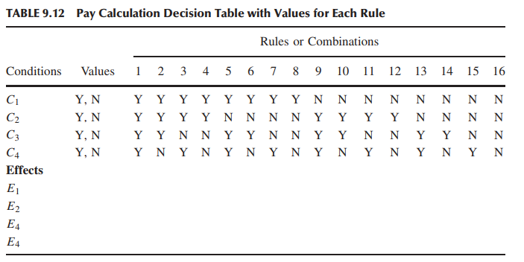
Example
Step 2: The decision table with all the conditions and the effects

Slide 31
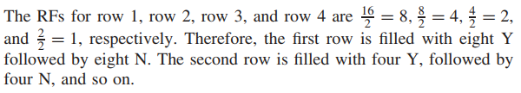
Example
Step 3: The total number of combinations is 2⁴ = 16 Step 4:

Slide 32
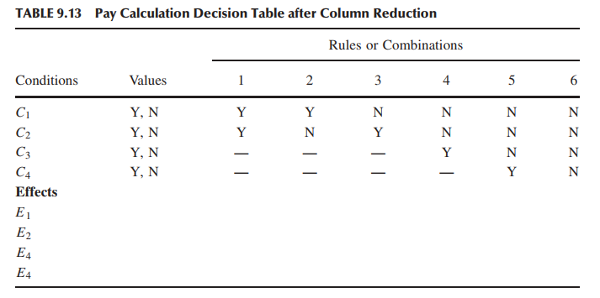
Example
Step 5: Reduce the number of rules

Slide 33
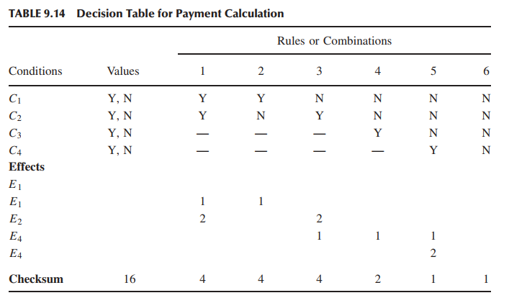
Example
Step 6: The checksum for columns

Slide 34
Example
Step 7: In this step, the effects are included for each column (rule)

Slide 35
Example
Step 8: A test case purpose can be generated from column 1 which can be described as follows:
If an employee is a permanent worker and worked less than 40 hours per week, then the system should pay his or her salary and generate an absence report.
Similarly, other test cases can be generated from the rest of the columns.

Slide 36
5. Random testing
In the random testing approach, test inputs are selected randomly from the input domain of the system
Random testing can be summarized as:
Step 1 : The input domain is identified
Step 2 : Test inputs are selected independently from the domain
Step 3 : The system under test is executed on these inputs
The inputs constitute a random test set
Step 4 : The results are compared to the system specification.
The test is a failure if any input leads to incorrect results
Otherwise it is a success.

Slide 37
5. Random testing
Random testing gives us an advantage of easily estimating software reliability from test outcomes
Test inputs are randomly generated according to an operational profile, and failure times are recorded
The data obtained from random testing can then be used to estimate reliability

Slide 38
5. Random testing
Computing expected outcomes becomes difficult, if the inputs are randomly chosen
Therefore, the technique requires good test oracles to ensure the adequate evaluation of test results
A test oracle is a mechanism that verifies the correctness of program outputs

Slide 39
5. Random testing
An oracle provides a method to
generate expected results for the test inputs, and
compare the expected results with the actual results of execution of the Implementation Under Test (IUT)
Four common types of oracles are as follows:
Perfect oracle
Gold standard oracle
Parametric oracle
Statistical oracle

Slide 40
Adaptive Random testing
In adaptive random testing the test inputs are selected from the randomly generated set in such a way that these are evenly spread over the entire input domain
The goal is to select a small number of test inputs to detect the first failure
A number of random test inputs are generated, then the “best” one among them is selected

Slide 41
Adaptive Random testing
We need to make sure the selected new test input should not be too close to any of the previously selected ones
That is, try to distribute the selected test inputs as spaced out as possible

Slide 42
6. Error guessing
It is a test case design technique where a test engineer uses his experience to
guess the types and probable locations of defects, and
design tests specifically to reveal the defects
Though experience is of much use in guessing errors, it is useful to add some structure to the technique
It is good to prepare a list of types of errors that can be uncovered
The error list can aid us in guessing where errors may occur. Such a list should be maintained from experience gained from earlier test projects

Slide 43
Một số câu hỏi trắc nghiệm
Question1: A program validates a numeric field as follows: Values less than 10 are rejected, values between 10 and 21 are accepted, values greater than or equal to 22 are rejected. Which of the following input values cover all of the equivalence partitions? A. 10, 11, 21 B. 3, 20, 21 C. 3, 10, 22 D. 10, 21, 22 Hãy chọn đáp án đúng.
Notes:
Chọn đáp án C

Slide 44
Một số câu hỏi trắc nghiệm
Question2: If the temperature falls below 18 degrees, the heating is switched on. When the temperature reaches 21 degrees, the heating is switched off. What is the minimum set of test input values to cover all valid equivalence partitions? A. 15, 19 and 25 degrees B. 17, 18, 20 and 21 degrees C. 18, 20 and 22 degrees D. 16 and 26 degrees
Hãy chọn đáp án đúng.
Notes:
đáp án đúng D vì chỉ hỏi lớp tương đương hợp lệ

Slide 45
Một số câu hỏi trắc nghiệm
Question 3: In a system designed to work out the tax to be paid: An employee has £4000 of salary tax-free. The next £1500 is taxed at 10%. The next £28000 after that is taxed at 22%. Any further amount is taxed at 40%.
To the nearest whole pound, which of these groups of numbers fall into three DIFFERENT equivalence classes? A. £4000; £5000; £5500 B. £32001; £34000; £36500 C. £28000; £28001; £32001 D. £4000; £4200; £5600
Notes:
Solution The classes will be as follows: Class I : 0 to £4000 => no tax Class II : £4001 to £5500 => 10 % tax Class III : £5501 to £33500 => 22 % tax Class IV : £33501 and above => 40 % tax
Select the values which fall in three different equivalence classes. Option ‘d’ has values from three different equivalence classes. So the answer is ‘D’.

Slide 46
Một số câu hỏi trắc nghiệm
Question 4 A program validates a numeric field as follows: values less than 10 are rejected, values between 10 and 21 are accepted, values greater than or equal to 22 are rejected. Which of the following covers the MOST boundary values?
a. 9,10,11,22 b. 9,10,21,22 c. 10,11,21,22 d. 10,11,20,21
Notes:
Solution We have already come up with the classes as shown in question 5. The boundaries can be identified as 9, 10, 21, and 22. These four values are in option ‘b’. So answer is ‘B’

Slide 47
Một số câu hỏi trắc nghiệm
Question 5: A system designed to work out the tax to be paid: An employee has £4000 of salary tax-free. The next £1500 is taxed at 10%. The next £28000 after that is taxed at 22%. Any further amount is taxed at 40%.
To the nearest whole pound, which of these is a valid Boundary Value Analysis test case? a) £28000 b) £33501 c) £32001 d) £1500
Notes:
Solution The classes are already divided in question # 7. We have to select a value which is a boundary value (start/end value). 33501 is a boundary value. So the answer is ‘B’.

Slide 48
Một số câu hỏi trắc nghiệm
Question 6: A wholesaler sells printer cartridges. The minimum order quantity is 5. There is a 20% discount for orders of 100 or more printer cartridges. You have been asked to prepare test cases using various values for the number of printer cartridges ordered. Which of the following groups contain three test inputs that would be generated using Boundary Value Analysis?
A. 5, 6, 20 B. 4, 5, 80 C. 4, 5, 99 D. 1, 20, 100
Notes:
Đáp án C

Slide 49
Bài tập 1
A mail order company charges $2.95 postage for deliveries if the package weighs less than 2 kg, $3.95 if the package weighs 2 kg or more but less than 5 kg, and $5 for packages weighing 5 kg or more.
Generate a set of valid test cases using equivalence partitioning.
Notes:
Gói hàng nặng<2kg thì tính phí $2.95
2kg< Gói hàng nặng <5kg thì tính phí $3.95
Gói hàng nặng>=5kg thì tính phí $5
Có 3 lớp tương đương hợp lệ, chọn 1 giá trị đại diện để test

Slide 50
Bài tập 2: về phân vùng tương đương và phân tích giá trị biên
Nếu bạn đi xe điện chuyến trước 9:30 sáng hoặc từ sau 4:00 chiều đến 7:30 tối (giờ cao điểm), thì bạn phải mua vé thường. Vé tiết kiệm (giá thấp hơn vé thường) có hiệu lực cho các chuyến xe từ 9:30 sáng đến 4:00 chiều và sau 7:30 tối.
Dựa vào yêu cầu trên, các bạn hãy:
Liệt kê ra các vùng và các giá trị biên để kiểm thử thời gian của tàu đối với các loại vé.
Liệt kê các vùng hợp lệ và không hợp lệ. Cho biết đâu là giá trị biên (Dùng bảng để dễ liệt kê các vùng tương đương và các giá trị biên)
Viết test case để test yêu cầu trên dựa vào các vùng tương đương và giá trị biên.

Slide 51
Đáp án
Lịch trình | <=9.29 am | 9.30am – 4:00pm | 4:01pm – 7:30pm | >=7:31pm
Loại vé | Vé thường | Vé tiết kiệm | Vé thường | Vé tiết kiệm
Notes:
Có 4 vùng tương đương
Các giá trị biên: 9:29am, 9:30am, 4:00pm, 4:01pm, 7:30pm, 7:31pm
Gồm 10 testcase cho 4 vùng và 6 giá trị biên

Slide 52
Bài tập 3
Khách hàng yêu cầu rút tiền mặt, máy ATM sẽ đưa ra số tiền được rút
Nếu khách hàng có đủ tiền trong tài khoản của họ. Hoặc là,
Nếu khách hàng được cấp thẻ tín dụng với số dư thích hợp.
Yêu cầu: áp dụng bảng quyêt định để thiết kế test case cho bài tập trên.

Slide 53
Phân tích yêu cầu
Phân tích bài toán như sau: “Số tiền sẽ rút được nếu số tiền yêu cầu nằm trong phạm vi cho phép của số dư hoặc nếu thẻ tín dụng của khách hàng có thể đảm bảo số tiền được rút“
Conditions:
Tổng số tiền cần rút ≤ số dư
Có thẻ tín dụng
Action :
Số tiền rút được đưa ra

Slide 54
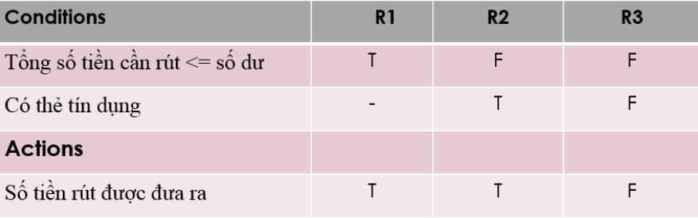
Bảng quyết định

Slide 55
Viết test case
Ít nhất 1 test case ứng với 1 cột
Test case cho R1: Số dư = 200, Số tiền yêu cầu rút = 200. Kết quả: Số tiền rút được đưa ra .
Test case cho R2: Số dư = 100, Số tiền yêu cầu rút = 200, Có thẻ tín dụng. Kết quả: Số tiền rút được đưa ra .
Test case cho R3: Số dư = 100, Số tiền yêu cầu rút = 200, Ko có thẻ tín dụng. Kết quả: Số tiền rút ko được đưa ra .

Slide 56

Bài tập 5: Lập bảng quyêt định
Hình 1: Form upload hình ảnh.
Điều kiện upload thành công là:
Hình ảnh phải có định dạng .JPG.
Kích thước của file hình ảnh từ 32kb trở xuống.
Độ phân giải: 137*177.
Nếu có điều kiện nào không thỏa việc upload ảnh sẽ không thành công và hệ thống sẽ gửi thông báo tương ứng đến người dùng. Ngược lại hình sẽ được upload thành công.

Slide 57
Từ các yêu cầu trên chúng ta có được bảng quyết định cho form upload ảnh như sau:
Điều kiện | Trường hợp 1 | Trường hợp 2 | Trường hợp 3 | Trường hợp 4 | Trường hợp 5 | Trường hợp 6 | Trường hợp 7 | Trường hợp 8
Định dạng | .jpg | .jpg | .jpg | .jpg | Không phải .jpg | Không phải .jpg | Không phải .jpg | Không phải .jpg
Kích thước | < 32 Kb | < 32 Kb | >= 32 Kb | >= 32 Kb | < 32 Kb | < 32 Kb | >= 32 Kb | >= 32 Kb
Độ phân giải | 137*177 | Không phải 137*177 | 137*177 | Không phải 137*177 | 137*177 | Không phải 137*177 | 137*177 | Không phải 137*177
Kết quả | Upload ảnh thành công | Thông báo lỗi "Độ phân giải chưa đúng" | Thông báo lỗi "Kích thước chưa đúng" | Thông báo lỗi "Kích thước và Độ phân giải chưa đúng" | Thông báo lỗi "Định dạng chưa đúng" | Thông báo lỗi "Định dạng và Độ phân giải chưa đúng" | Thông báo lỗi "Định dạng và Kích thước chưa đúng" | Thông báo lỗi "Định dạng, Kích thước và Độ phân giải chưa đúng"

Slide 58
Bài tập 6: Bài toán Đóng phí bảo hiểm xe hơi
Xét đặc tả của một hệ thống đóng phí bảo hiểm xe hơi. Đối với nữ < 65 tuổi, phí bảo hiểm là: 500$
Đối với nam < 25 tuổi, phí bảo hiểm là: 3000$
Đối với nam từ 25 đến 64, phí bảo hiểm là: 1000$ •
Nếu tuổi từ 65 trở lên, phí bảo hiểm là: 1500$

Slide 59
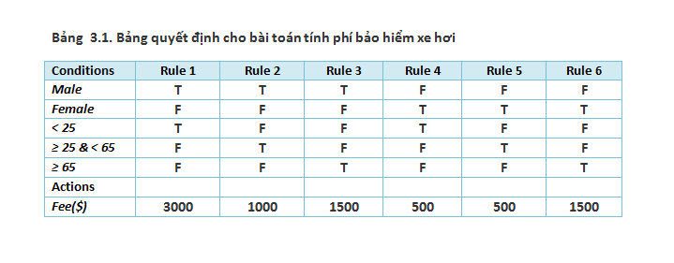
Đáp án
Notes:
Cách 1: Sau khi loại trừ các kết hợp điều kiện không hợp lý (ví dụ như không thể vừa là nam vừa là nữ, không thể < 25 tuổi và >65 tuổi...) thì số cột của bảng sẽ hiển thị như trên hình 3.1.
Cách 2: Hoặc chúng ta xác định 4 điều kiện: Nam?, <25,>=25&<65, >=65

Slide 60
THE END

